Slide 1





Corona Virus Analysis

Slide 2
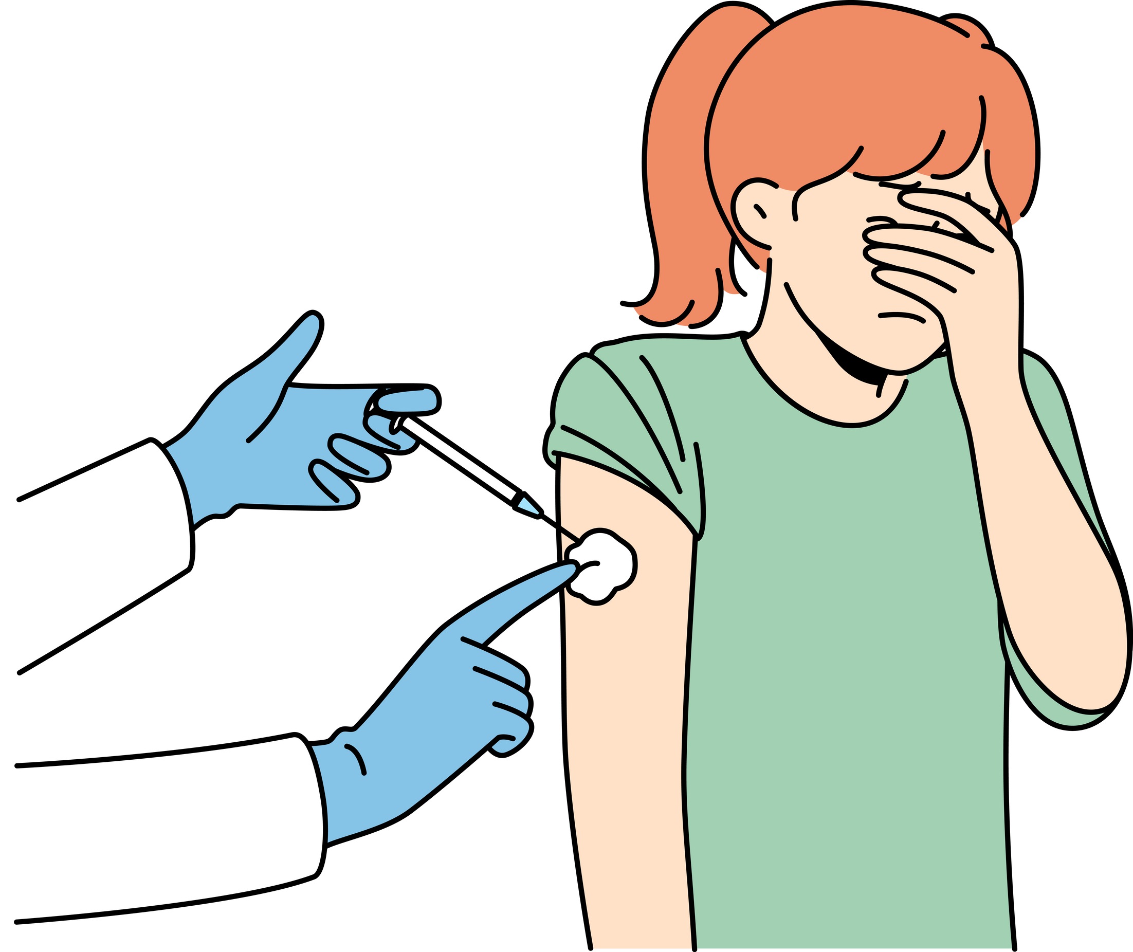
Project Overview
The COVID-19 pandemic, caused by the SARS-CoV-2 virus, has been a global health crisis with far-reaching implications. Our project aims to analyze the spread and impact of the virus using a dataset that includes critical features such as Province, Country_Region, Latitude, Longitude, Date, Confirmed, Deaths, and Recovered cases.

Slide 3
Project Objective
The primary objective is to understand the geographical spread, temporal trends, and recovery rates of COVID-19. By analyzing this data, we aim to identify patterns and correlations that can inform public health decisions and strategies.

Slide 4
Columns Description
Province: This column records the specific province or state within a country where the data was collected. It provides a more localized view of the pandemic’s impact within a country.
Country_Region: This column indicates the country or region where the data was recorded. It is essential for country-level analysis and understanding the global spread of the virus.
Latitude: The latitude coordinate of the location for which the data is reported. It helps in mapping the data geographically to analyze the spread patterns.
Longitude: The longitude coordinate of the location for which the data is reported. Along with latitude, it is used for geospatial analysis of the pandemic.
Date: This column typically records the date when the data was collected or reported. If the ‘Date IS NULL’ is mentioned, it indicates that there are missing values in the date column which may need to be addressed during data preprocessing.
Confirmed: The total number of confirmed COVID-19 cases in the location as of the reported date. It is a key indicator of the spread of the virus.
Deaths: The total number of deaths attributed to COVID-19 in the location as of the reported date. This column is crucial for understanding the lethality of the virus.
Recovered: The total number of individuals who have recovered from COVID-19 in the location as of the reported date. It provides insights into the recovery rate and the effectiveness of treatment protocols.

Slide 5
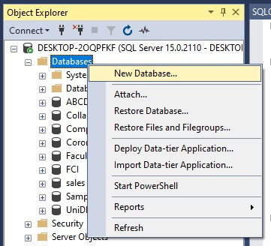
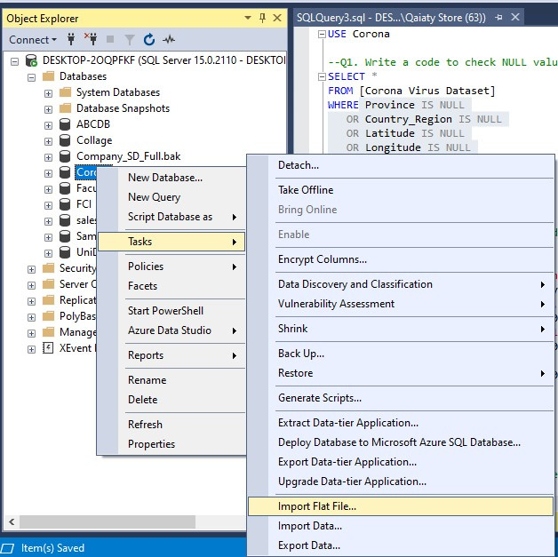

Creating Database & Importing Dataset

Slide 6
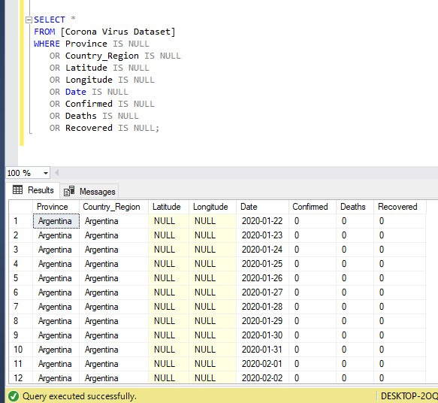
Q1. Write a code to check NULL values

Slide 7
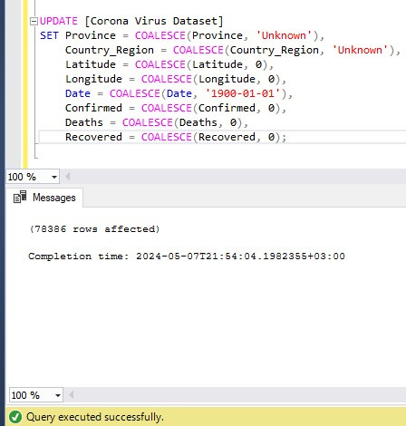
Q2. If NULL values are present, update them with zeros for all columns

Slide 8
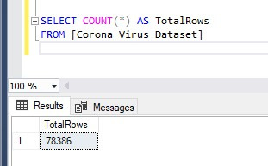
Q3. check total number of rows

Slide 9
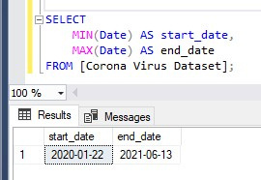
Q4. Check what is start_date and end_date

Slide 10
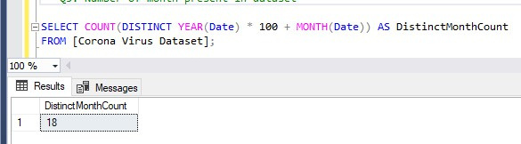
Q5. Number of month present in dataset

Slide 11
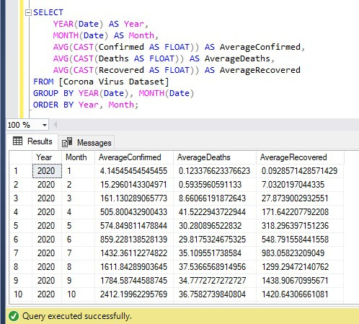
Q6. Find monthly average for confirmed, deaths, recovered

Slide 12
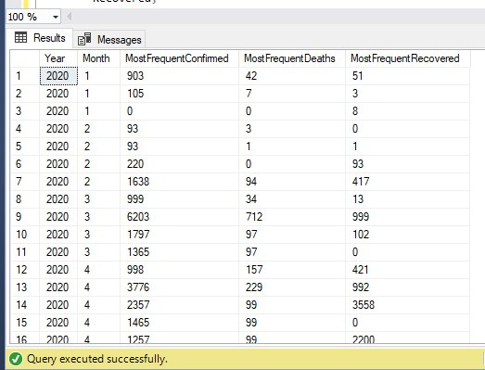
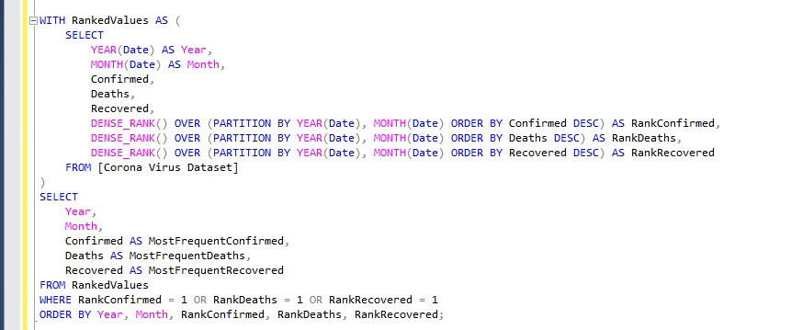
Q7. Find most frequent value for confirmed, deaths, recovered each month

Slide 13
Q4. Check what is start_date and end_date

Slide 14
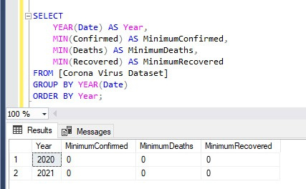
Q8. Find minimum values for confirmed, deaths, recovered per year

Slide 15
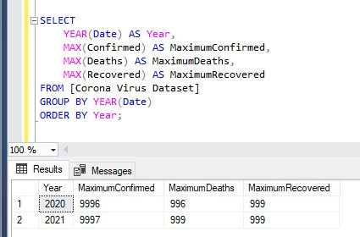
Q9. Find maximum values of confirmed, deaths, recovered per year

Slide 16
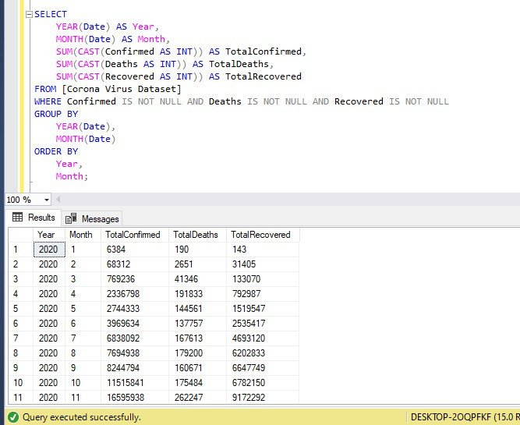
Q10. The total number of case of confirmed, deaths, recovered each month

Slide 17
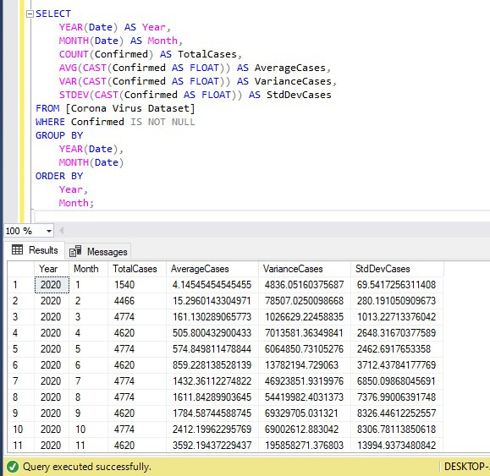
Q11. Check how corona virus spread out with respect to confirmed case (Eg.: total confirmed cases, their average, variance & STDEV )

Slide 18
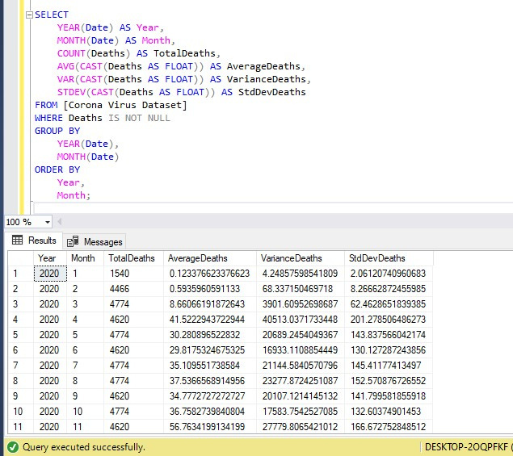
Q12. Check how corona virus spread out with respect to death case per month (Eg.: total confirmed cases, their average, variance & STDEV )

Slide 19
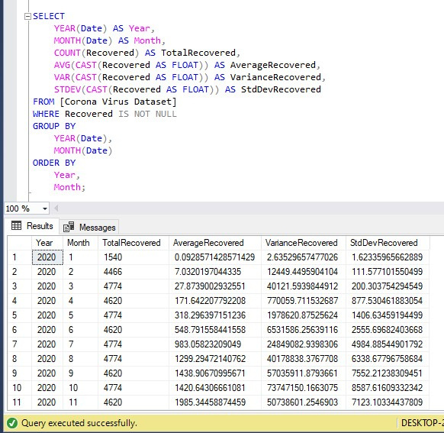
Q13. Check how corona virus spread out with respect to recovered case (Eg.: total confirmed cases, their average, variance & STDEV )

Slide 20
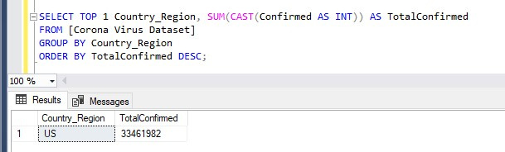
Q14. Find Country having highest number of the Confirmed case

Slide 21
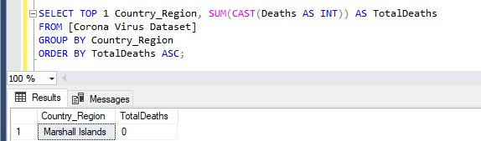
Q15. Find Country having lowest number of the death case

Slide 22
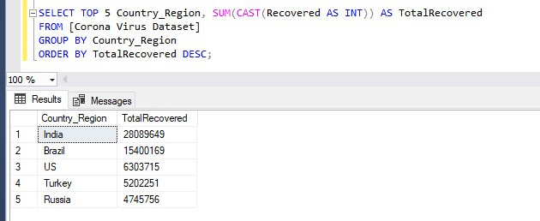
Q16. Find top 5 countries having highest recovered case

Slide 23
Insights
1.COVID-19 Pandemic duration: January 22, 2020, to June 13, 2021.
2. India has the highest number of recovered cases.
3. Samoa, Kiribati, Dominica, and the Marshall Islands have the lowest death counts.
4. The US leads in confirmed COVID-19 cases.
5. Peak confirmed cases occurred in April 2021. 6. Peak death rate in January 2021

Slide 24

Thank You :)

